Slide 1
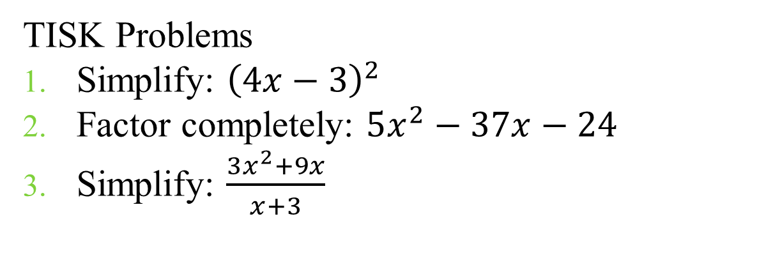
Friday, November 30, 2012
Agenda:
TISK, No MM
Upcoming Important Dates
Solve problems using properties of trapezoids and kites.
Homework: No HW – Project Work Weekend
TISK Problems
Simplify: ${\left(4x−3\right)}^{2}$
Factor completely: $5x^{2}−37x−24$
Simplify: $\frac{3x^{2}+9x}{x+3}$

Slide 2
§6.5 Trapezoids & Kites
Definitions
A trapezoid is a quadrilateral with exactly one pair of parallel sides.
  The parallel sides are the BASES
  A trapezoid also has two pairs of base angles.
An Isosceles Trapezoid is a trapezoid whose legs are congruent.

Slide 3
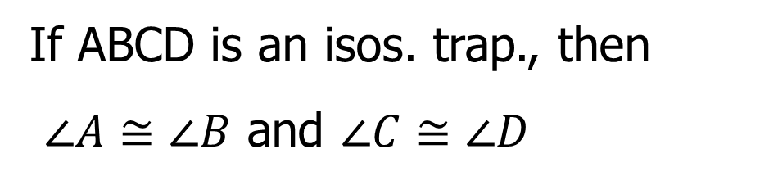
Theorems
If a trapezoid is isosceles, then each pair of base angles is congruent.
A
B
D
C
If ABCD is an isos. trap., then
$∠A≅∠B$ and $∠C≅∠D$

Slide 4
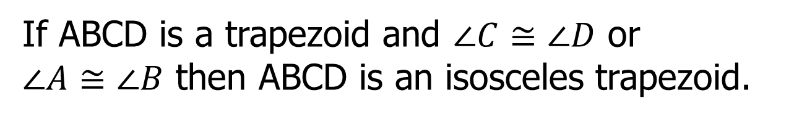
Theorems
If a trapezoid has a pair of congruent base angles, then it is an isosceles trapezoid.
A
B
D
C
If ABCD is a trapezoid and $∠C≅∠D$ or $∠A≅∠B$ then ABCD is an isosceles trapezoid.

Slide 5
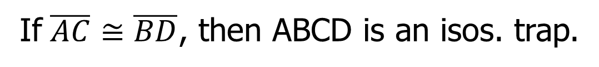

Theorems
A trapezoid is isosceles if and only if its diagonals are congruent.
B
C
A
D
If ABCD is an isos. trap., then $\overline{AC}≅\overline{BD}$
If $\overline{AC}≅\overline{BD}$, then ABCD is an isos. trap.

Slide 6








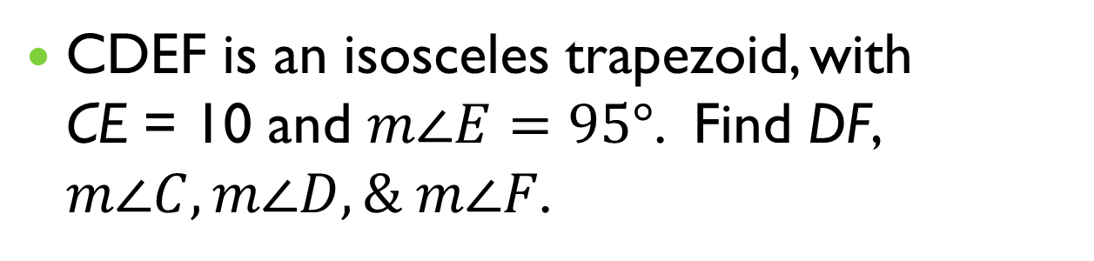









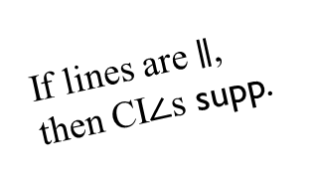
Examples
CDEF is an isosceles trapezoid, with
CE = 10 and $m∠E=95°$. Find DF, $m∠C, m∠D, \& m∠F$.
$$\overline{CE}≅\overline{DF}$$
$$∠C≅∠D$$
$$∠E≅∠F$$
C
D
$$CE=DF$$
$$m∠C=m∠D$$
$$m∠E=m∠F$$
$$m∠E+m∠D=180°$$
$$95°+m∠D=180°$$
1$0$
If a trap. is isos., then each pair of base $∠$s are $≅$
A trap. is isos. iff its diag’s are $≅$
If a trap. is isos., then each pair of base $∠$s are $≅$
95$°$
If lines are $∥$, then CI$∠$s supp.
F
E
$$DF=10$$
$$m∠F=95°$$
$$m∠C=85°$$
$$m∠D=85°$$

Slide 7


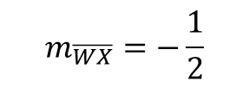


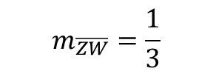


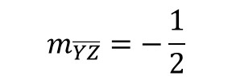



Examples
The vertices of WXYZ are W(-1, 2),
X(3, 0), Y(4, -3), and Z(-4, 1). Show that WXYZ is an isosceles trapezoid.
$$ZW=\sqrt{{\left(−4+1\right)}^{2}+{\left(1−2\right)}^{2}}$$
$∴$ it’s a trapezoid.
$$ZW=\sqrt{{\left(−3\right)}^{2}+{\left(−1\right)}^{2}}$$
$$m_{\overline{ZW}}=\frac{1}{3}$$
W
$$ZW=\sqrt{10}$$
$$m_{\overline{WX}}=−\frac{1}{2}$$
Z
$$XY=\sqrt{{\left(3−4\right)}^{2}+{\left(0−−3\right)}^{2}}$$
$$XY=\sqrt{{\left(−1\right)}^{2}+{\left(3\right)}^{2}}$$
X
$$m_{\overline{XY}}=−3$$
$$XY=\sqrt{10}$$
$$m_{\overline{YZ}}=−\frac{1}{2}$$
$∴$ it’s isosceles.
Y

Slide 8
Definitions
The midsegment of a trapezoid is the segment that connects the midpoints of its legs.
midsegments

Slide 9
Theorems
Midsegment Theorem for Trapezoids
  The midsegment of a trapezoid is parallel to each base and its length is one half the sum of the lengths of the bases.
A
B
E
F
D
C

Slide 10




Examples
A potter crafts a trapezoidal relish dish, placing a divider, shown by $\overline{AB}$, in the middle of the dish. How long must the divider be to ensure that it divides the legs in half?
8 in.
For the divider to divide the legs in half, it must be a midsegment.
$$∴AB=\frac{1}{2}(8+10)$$
A
B
$$AB=\frac{1}{2}(18)$$
10 in.
$AB=9$ in.

Slide 11
Check Points
The vertices of KLMN are K(-3, 5), L(0, 7),
M(2, 7), and N(3, 5). Is KLMN a trapezoid? If it is, tell whether it is isosceles and find its midsegment length.

Slide 12
Definitions
A kite is a quadrilateral that has two pairs of consecutive congruent sides, but opposite sides are not congruent.

Slide 13

Theorems
If a quadrilateral is a kite, then its diagonals are perpendicular.
B
A
C
D
If ABCD is a kite, then $\overline{AC}⊥\overline{BD}$

Slide 14
Theorems
If a quadrilateral is a kite, then exactly one pair of opposite angles are congruent.
B
A
C
D
If ABCD is a kite, then $∠B≅∠D$ and $∠A≇∠C$.

Slide 15


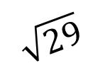
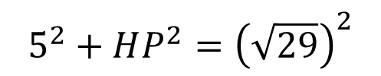

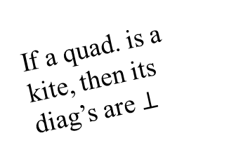

Examples
GHJK is a kite. Find HP.
$$5^{2}+HP^{2}={\left(\sqrt{29}\right)}^{2}$$
H
$$25+HP^{2}=29$$
$$\sqrt{29}$$
$$HP^{2}=4$$
5
$$HP=2$$
G
J
P
If a quad. is a kite, then its diag’s are $⊥$
K
In a rt. $Δ,$
$a^{2}+b^{2}=c^{2}$

Slide 16



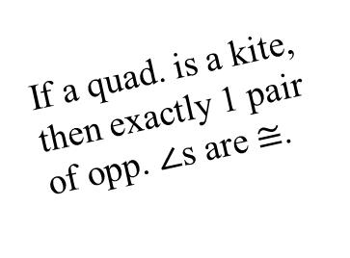







Examples
RSTU is a kite. Find $m∠R, m∠S,$and $m∠T$.
S
$$\left(x+30\right)°$$
R
$$x°$$
T
$$125°$$
U
$$125=m∠S$$
If a quad. is a kite, then exactly 1 pair of opp. $∠$s are $≅$.
The $∠$s of a quad. Sum to 360$°$.
$$250+x+30+x=360$$
$$280+2x=360$$
$$2x=80$$
$$x=40$$

Slide 17
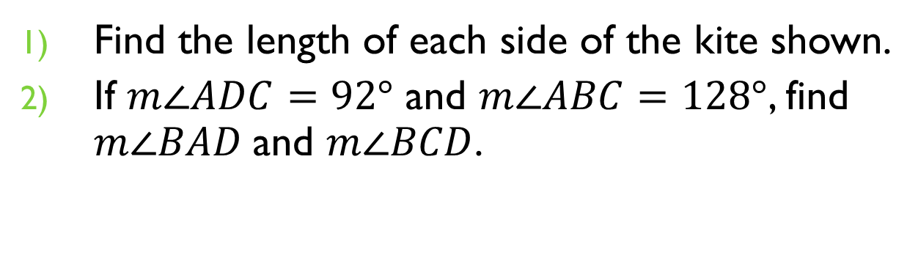
Check Points
Find the length of each side of the kite shown.
If $m∠ADC=92°$ and $m∠ABC=128°$, find $m∠BAD$and $m∠BCD$.
B
2
A
C
4
4
4
D

